Slide 1

Structured approach to data analytics
Sleep data-set
Presented by : Pegah Fattahi

Slide 2
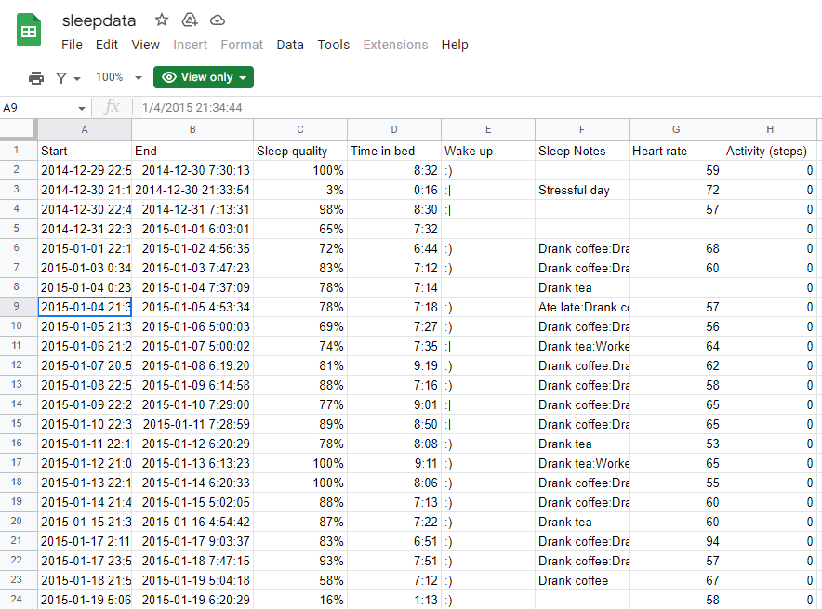
About data-set
This data-set is created out of the information gathered from a person about his/her sleeping behavior. The data-set tells us about the time in bed, the quality of time(percentage), sleep note(explaining about the personal day mood),heart rate and activity during the sleeping which is measure based on the steps.
TREY research

Slide 3

Major task
As a team of data-analyst the manager of our company assigned the team to do the analysis based on the data-set .Accordingly, the whole report will be presented to the related department.
TREY research

Slide 4



Data analysis 6 steps
Ask
Prepare
Process
Analyze
Share
Act
TREY research

Slide 5

Questions related to the data-set
To what percentage you evaluate the quality of your sleeping?
What is the maximum and minimum time you spend in bed?
Do you prefer to drink coffee or tea? Specify your answer for each day
What is your heart rate (min,max,avg) during the night?
Are you experiencing the night walk? Any specific type of movement during the sleeping time?
TREY research

Slide 6
Data pre-processing (cleaning, visualization)
Data is organized in columns and rows with a consistent format
The sort and filter function has been applied, to have a better insight and to identify the outliers.
The count blank function has been applied to identify the missing value in each cell.
After exploration process, data has been visualized applying graphs and bars.
TREY research

Slide 7
Conclusion
The data-set was found to be insufficient for making valid decisions. Due to missing values, lack of definitions. Thus, our team decided to send the final report to the manager and the related department. The research concluded that, according to the current data-set, a person's heart rate is highest on days when they drink tea or coffee. It has also been established that tea and coffee have been associated with a risk of cardiovascular disease (CVD), both positively and negatively. To gain a better understanding of the correlation between heart rate, tea and coffee, further information is required regarding the type of tea, coffee, person's health background information, etc. Furthermore, it was observed that the person experiences the lowest quality of sleep on stressful days, which was not surprising. At the same time, the highest quality of sleep was experienced on days when they drank coffee and tea, whether its a stressful day or the day he/she was doing sport.
TREY research

Slide 8

Thank You

